Slide 1

conFusion
a FUSION website
Presented by yours truly,
Aljon Viray, Lawrence Dizon, Dachelle Alo, Alfredo, Kae Ancheta

Slide 2
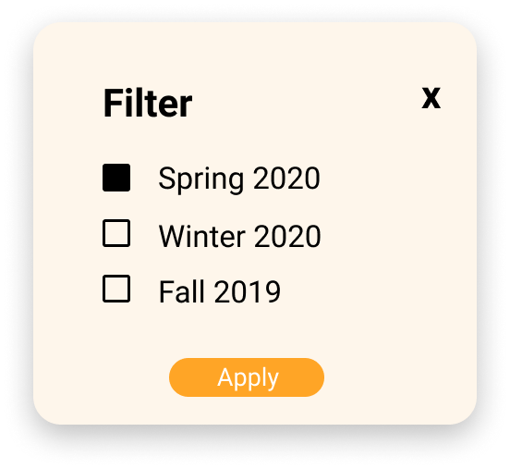
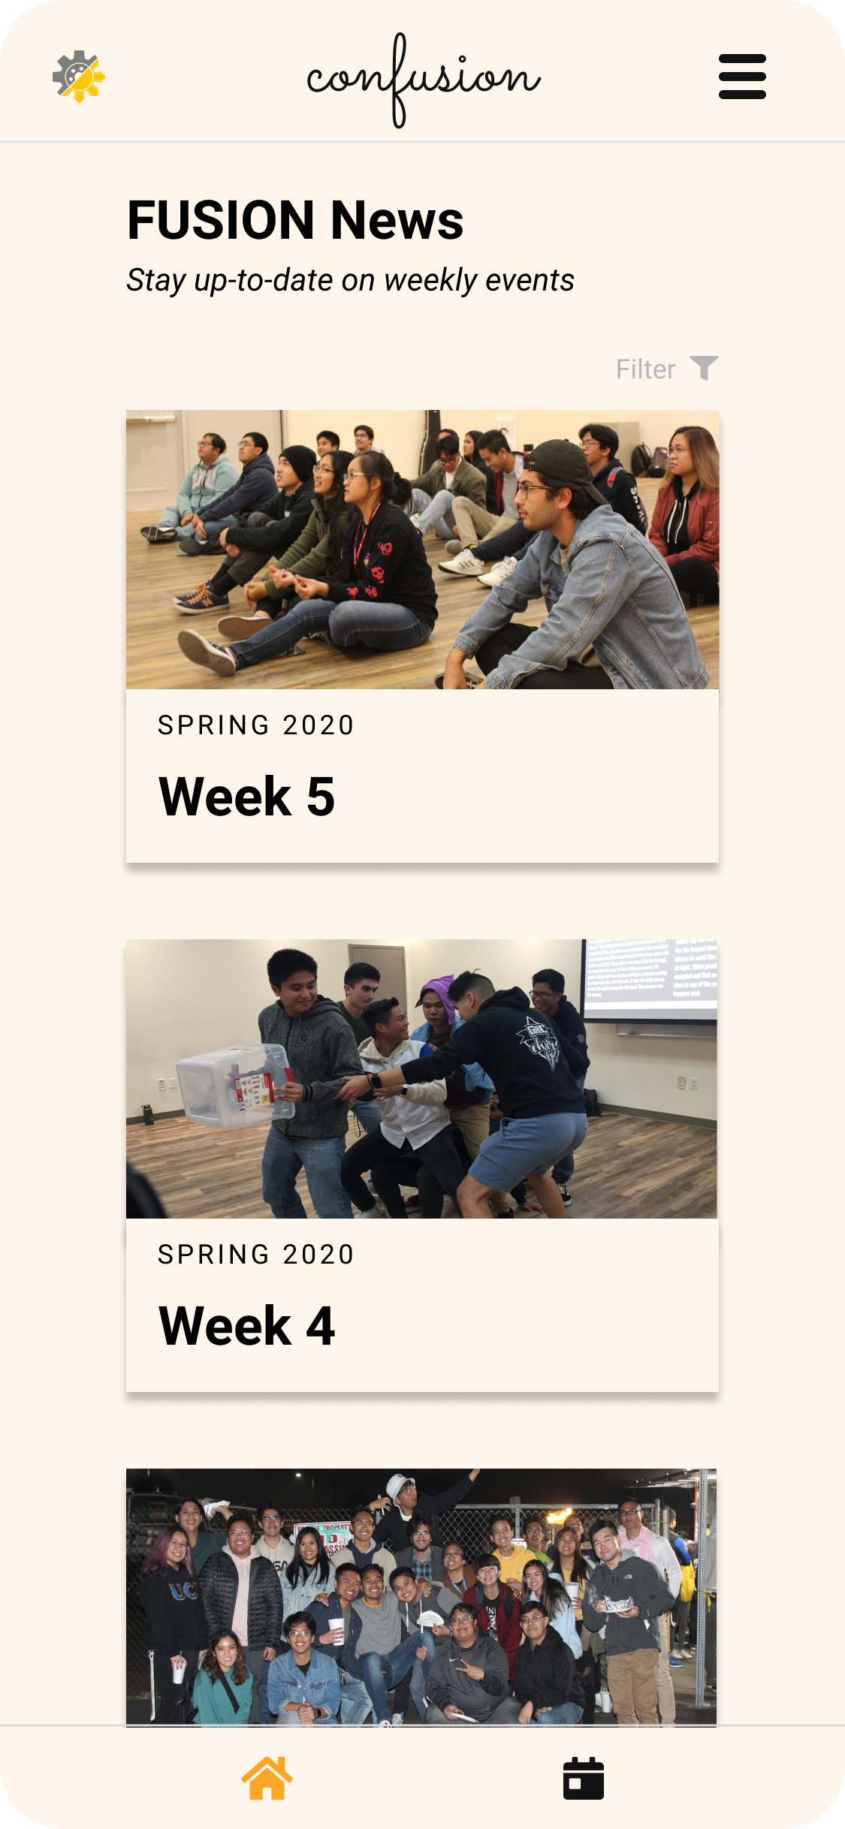
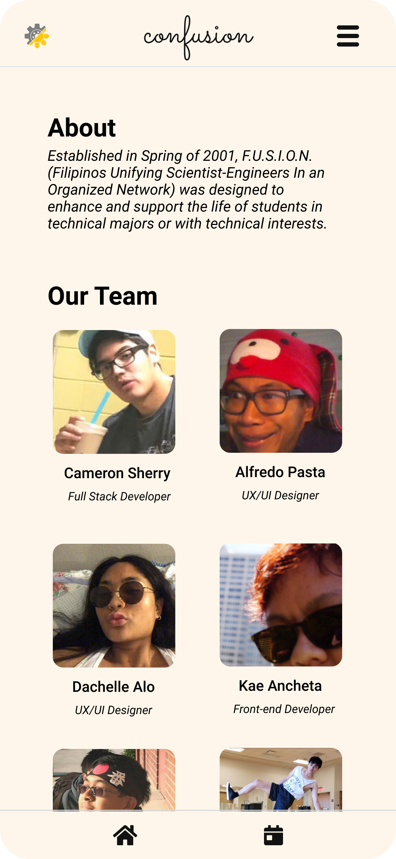
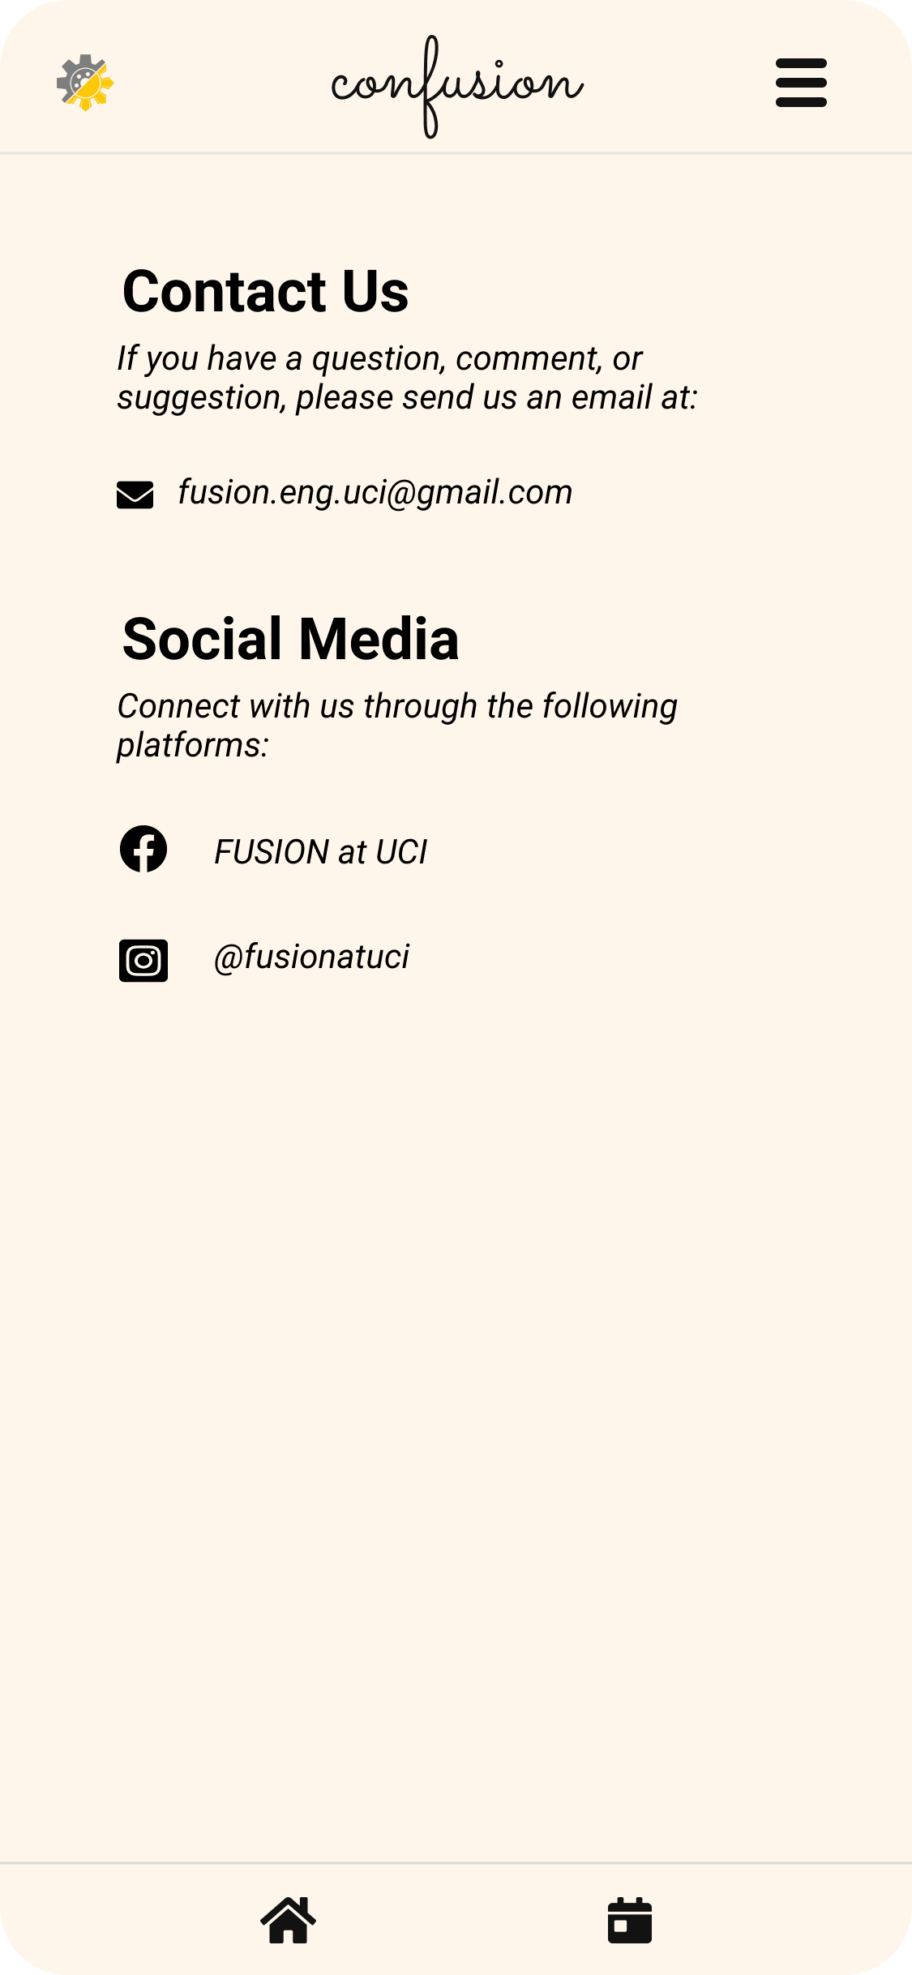
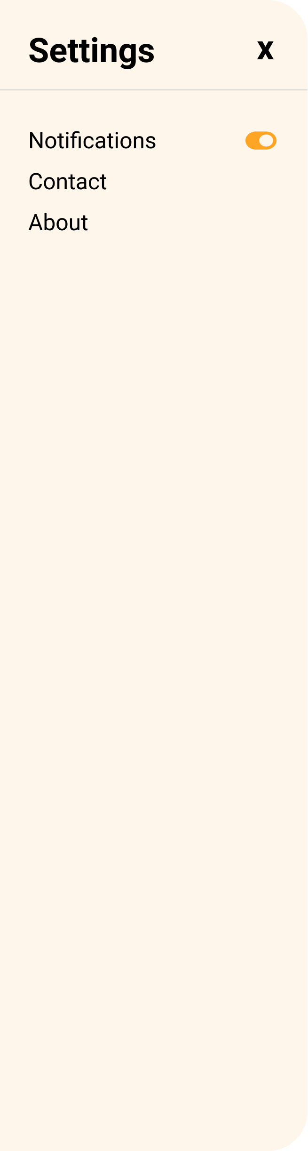
UI/UX Designs, Prototypes & High Hopes
LIGHT MODE!

Slide 3
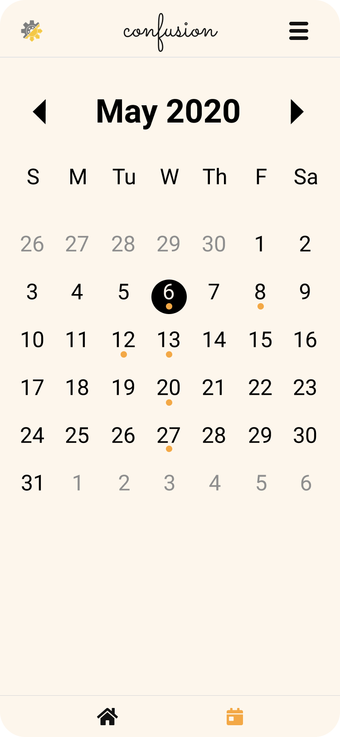
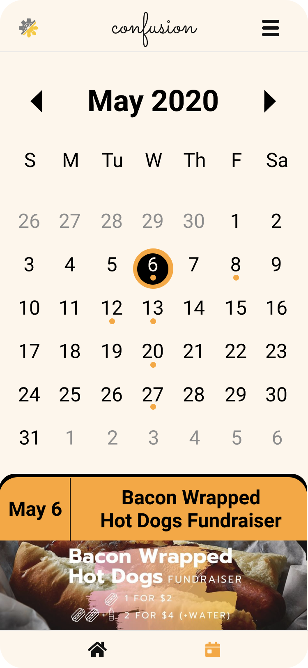
UI/UX Designs, Prototypes & High Hopes

Slide 4
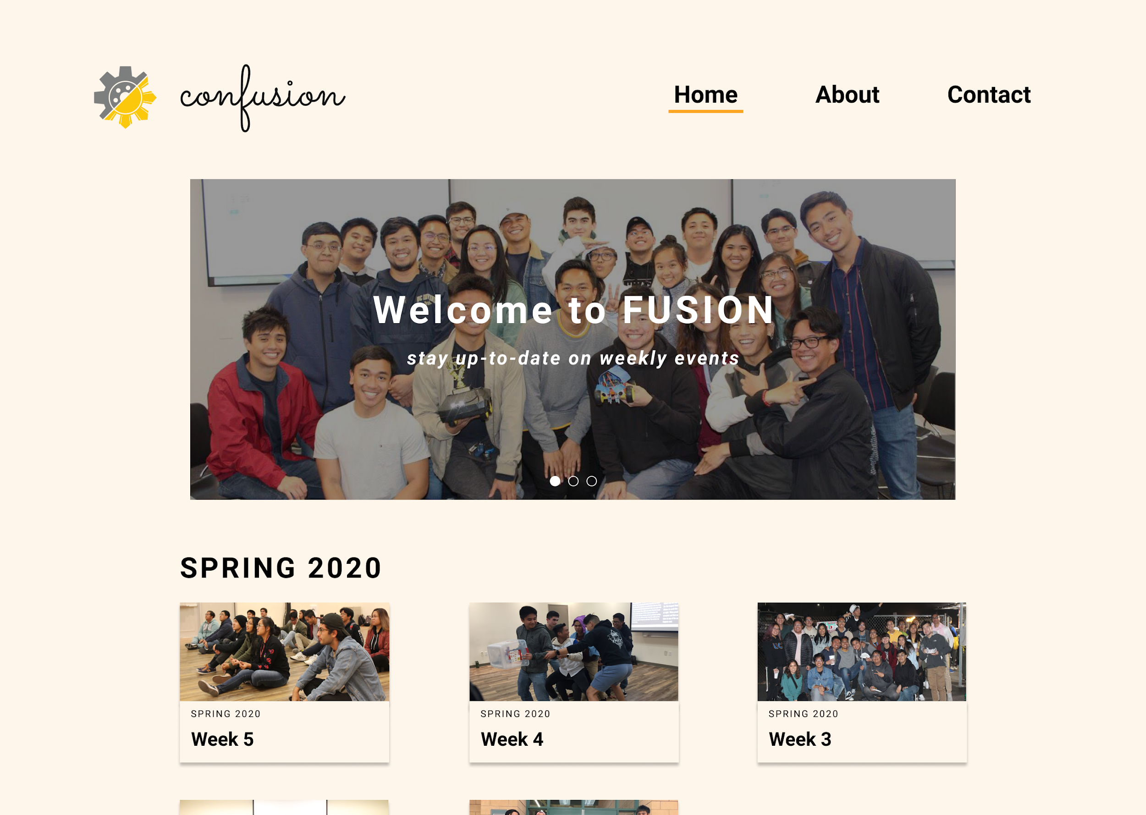
UI/UX Designs, Prototypes & High Hopes
LIGHT MODE!
(Desktop)
Notes:
Designed by Dachelle and Alfredo
Used

Slide 5
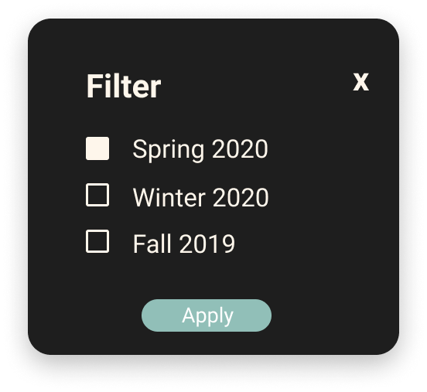
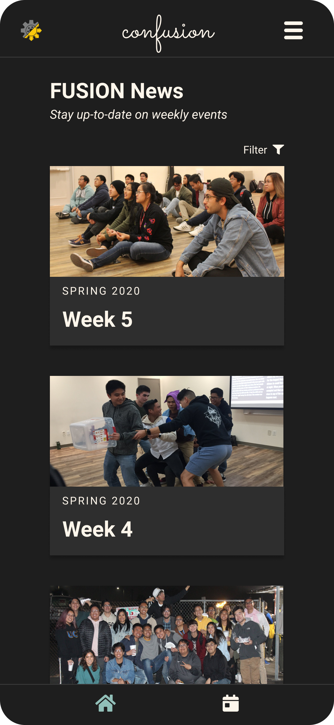
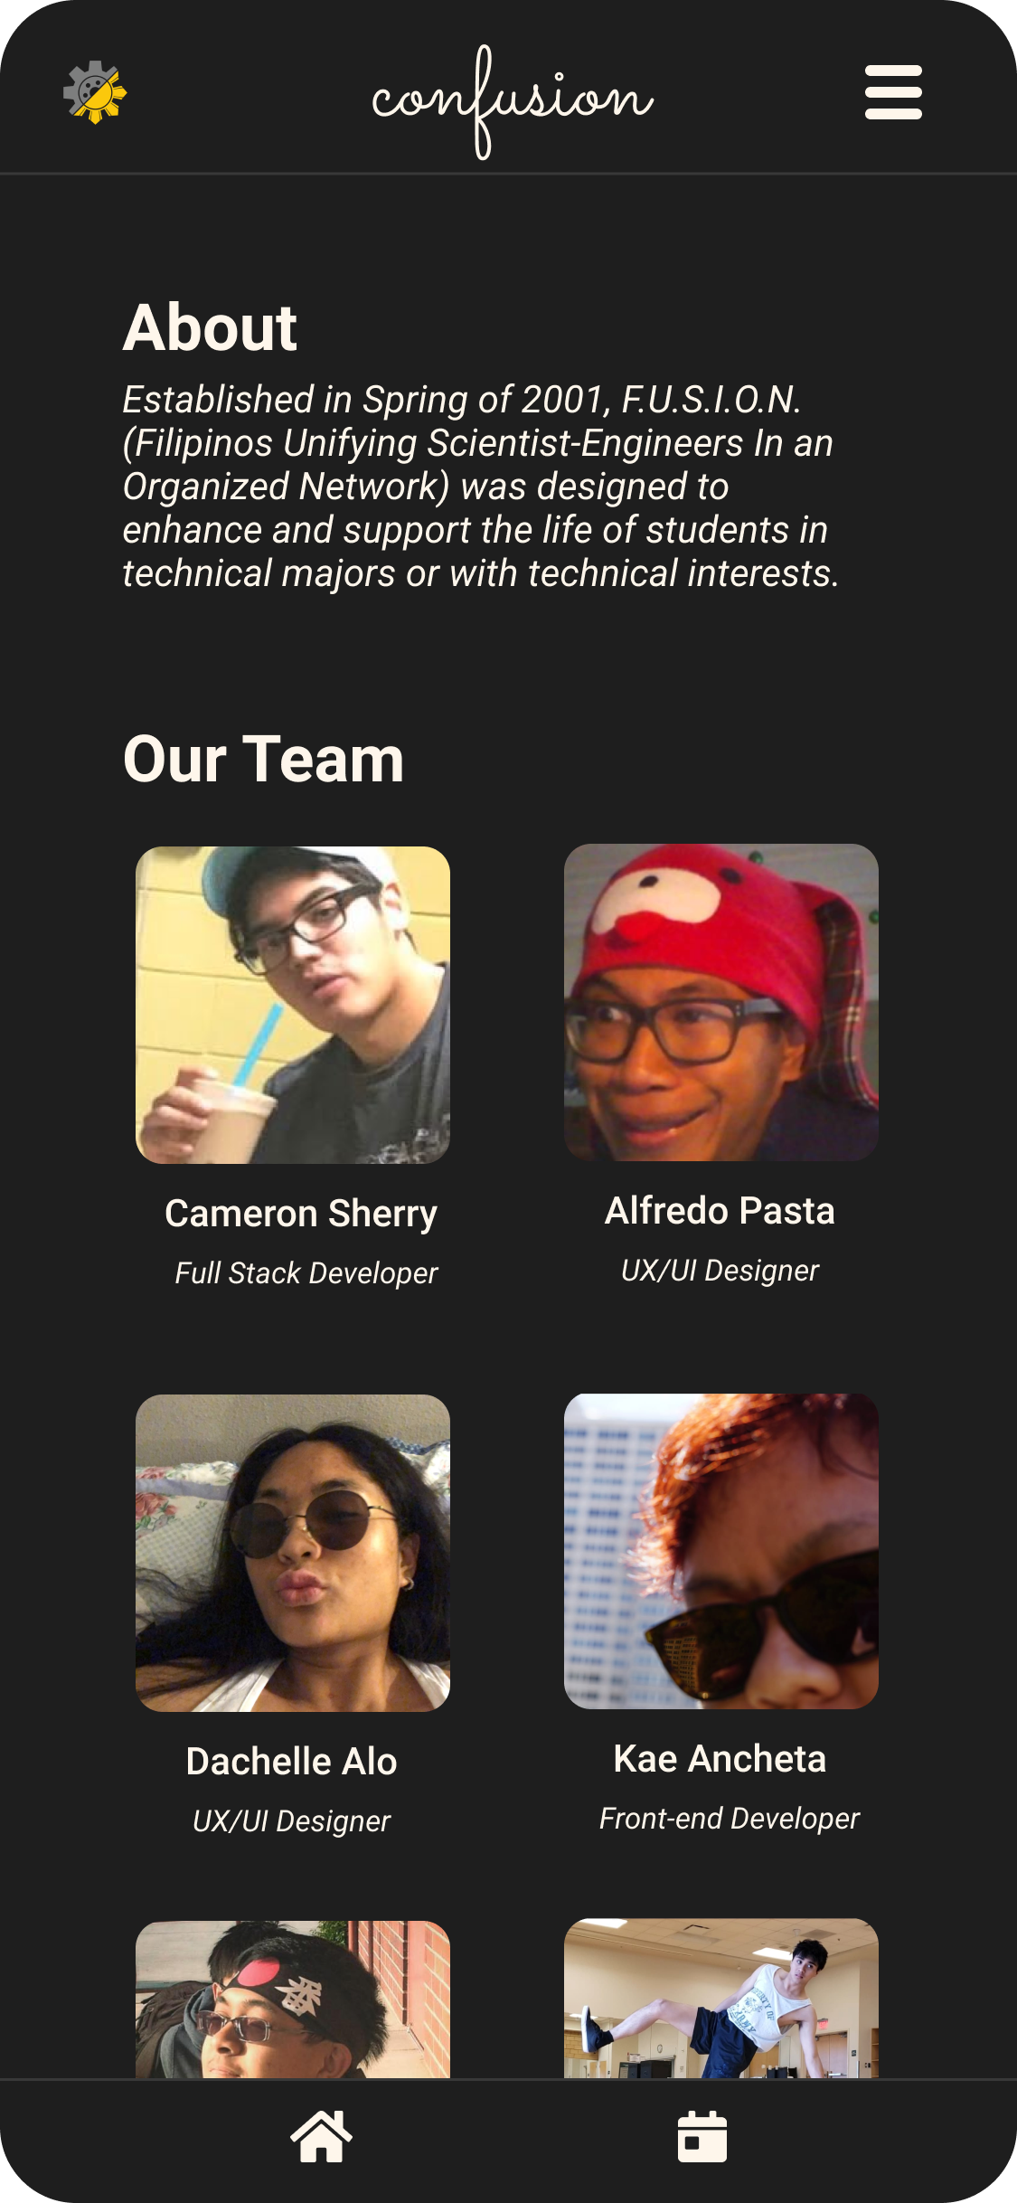
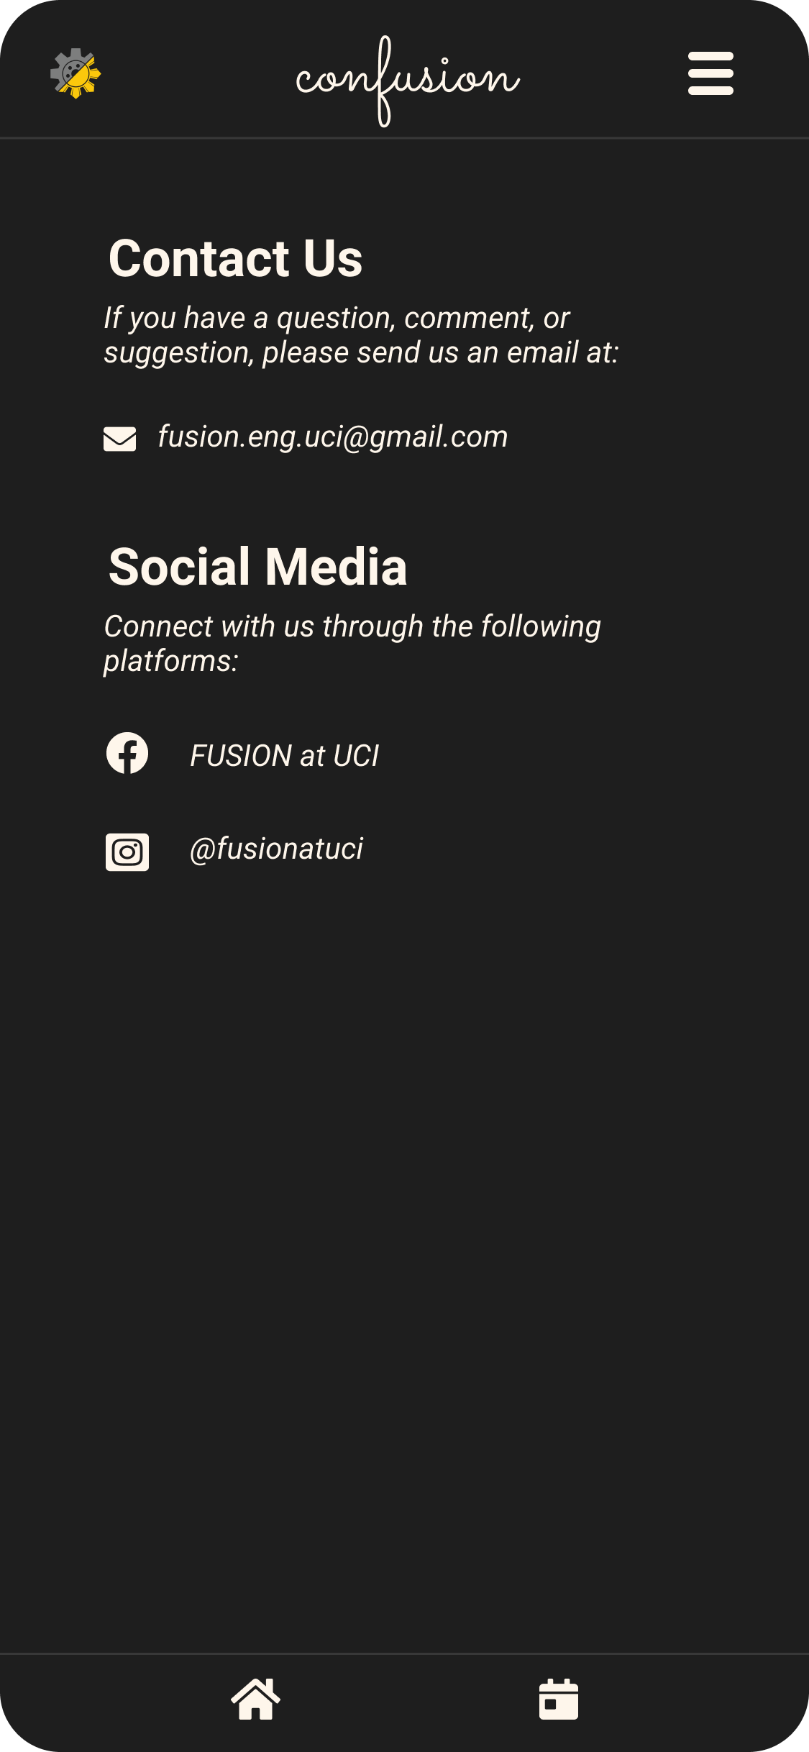
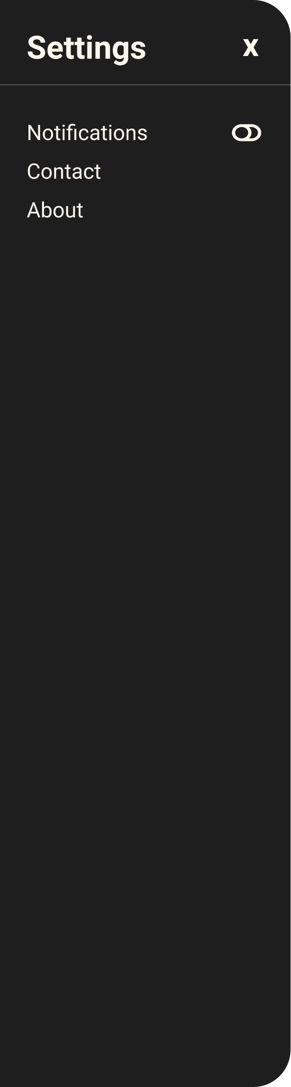
UI/UX Designs, Prototypes, & High Hopes
DARK MODE!

Slide 6
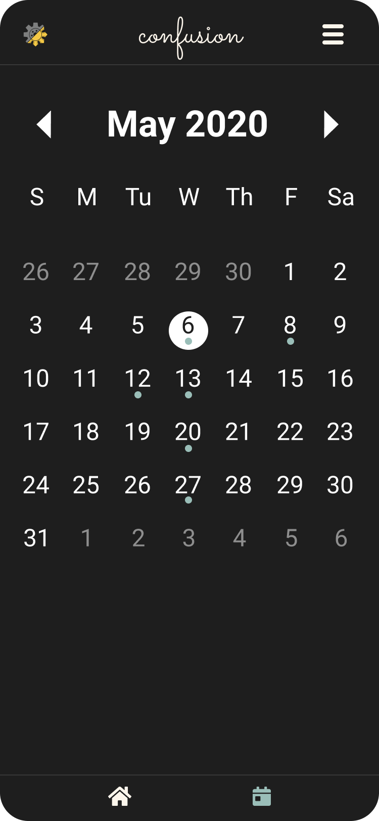
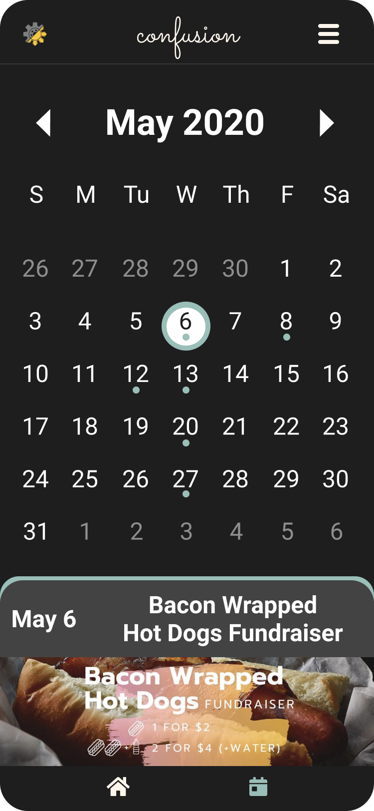
UI/UX Designs, Prototypes, & High Hopes

Slide 7
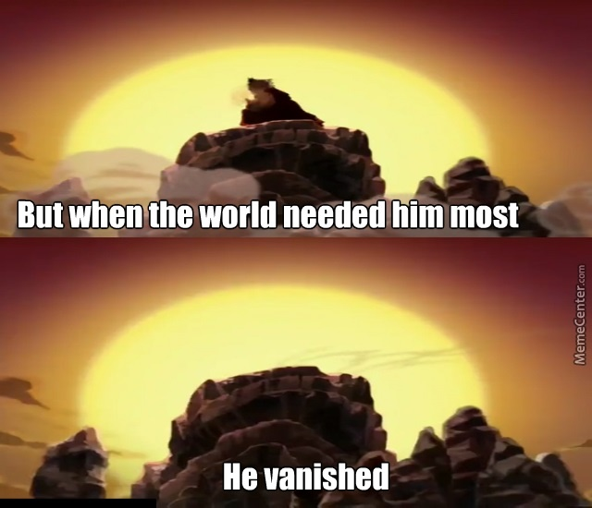


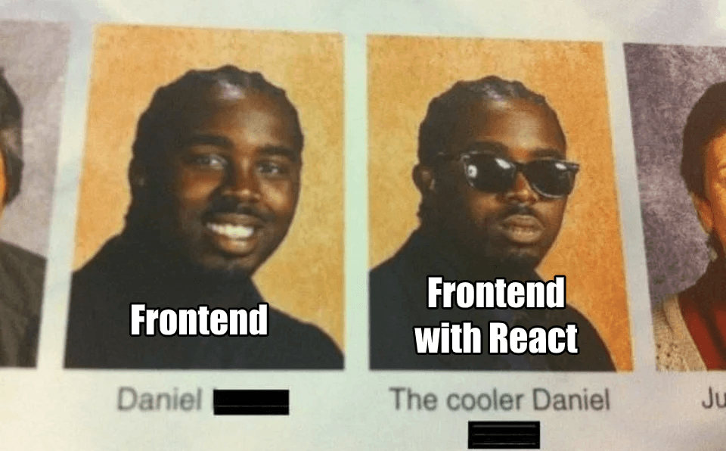

What Really Happened...
Where’s the Avatar?
Frontend got most of the UI/UX designs implemented
“Borrowed” 90% of the features from 3rd party libraries.
“Smart Move” Writing features from scratch is impossible in short time.
“Don’t have enough features for backend development”

Slide 8
What We Learned
If you intend to make an app, consider writing your code in React Native, not just React. “Why not react? Because it’s not native.”
“React Native is for mobile applications while React is for websites(front-end).”
Websites are easier to test (smartphones might not download/open foreign app)
React uses “JSX” which is a weird combination of HTML and JavaScript.
Also uses CSS files separately for styling visual elements (center text, orient images, etc.)
Learned how to use basic functions and syntax, but still confusing sometimes.
We shouldn’t expect ourselves to finish a whole app in <10 weeks with no experience in React, HTML, or JavaScript...

Slide 9
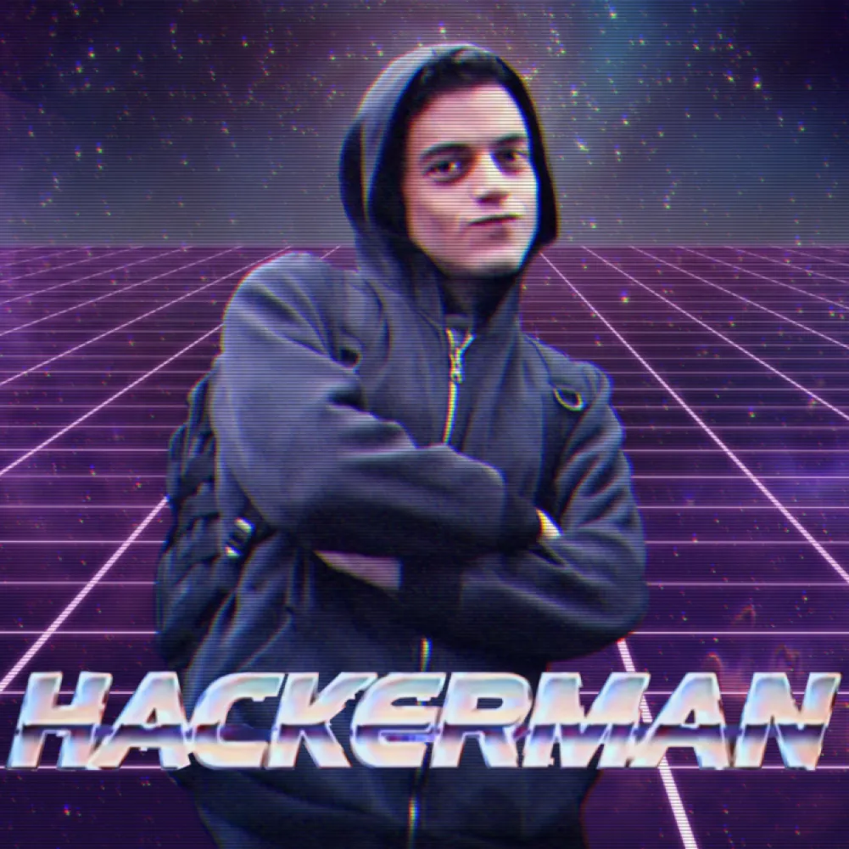
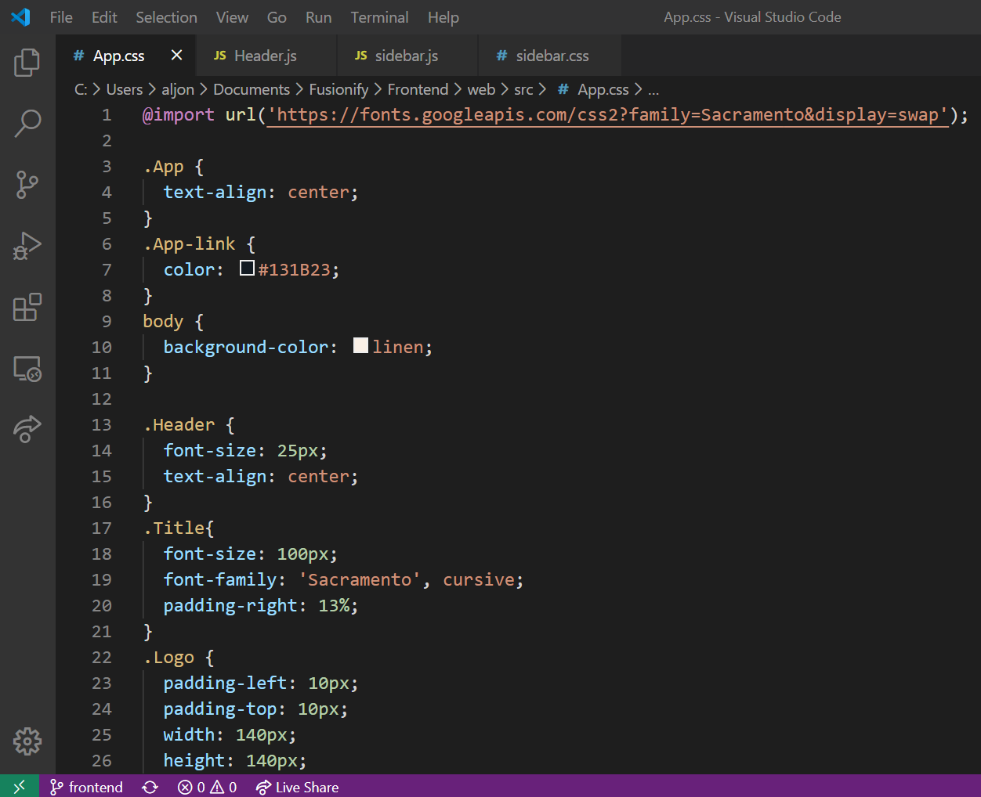
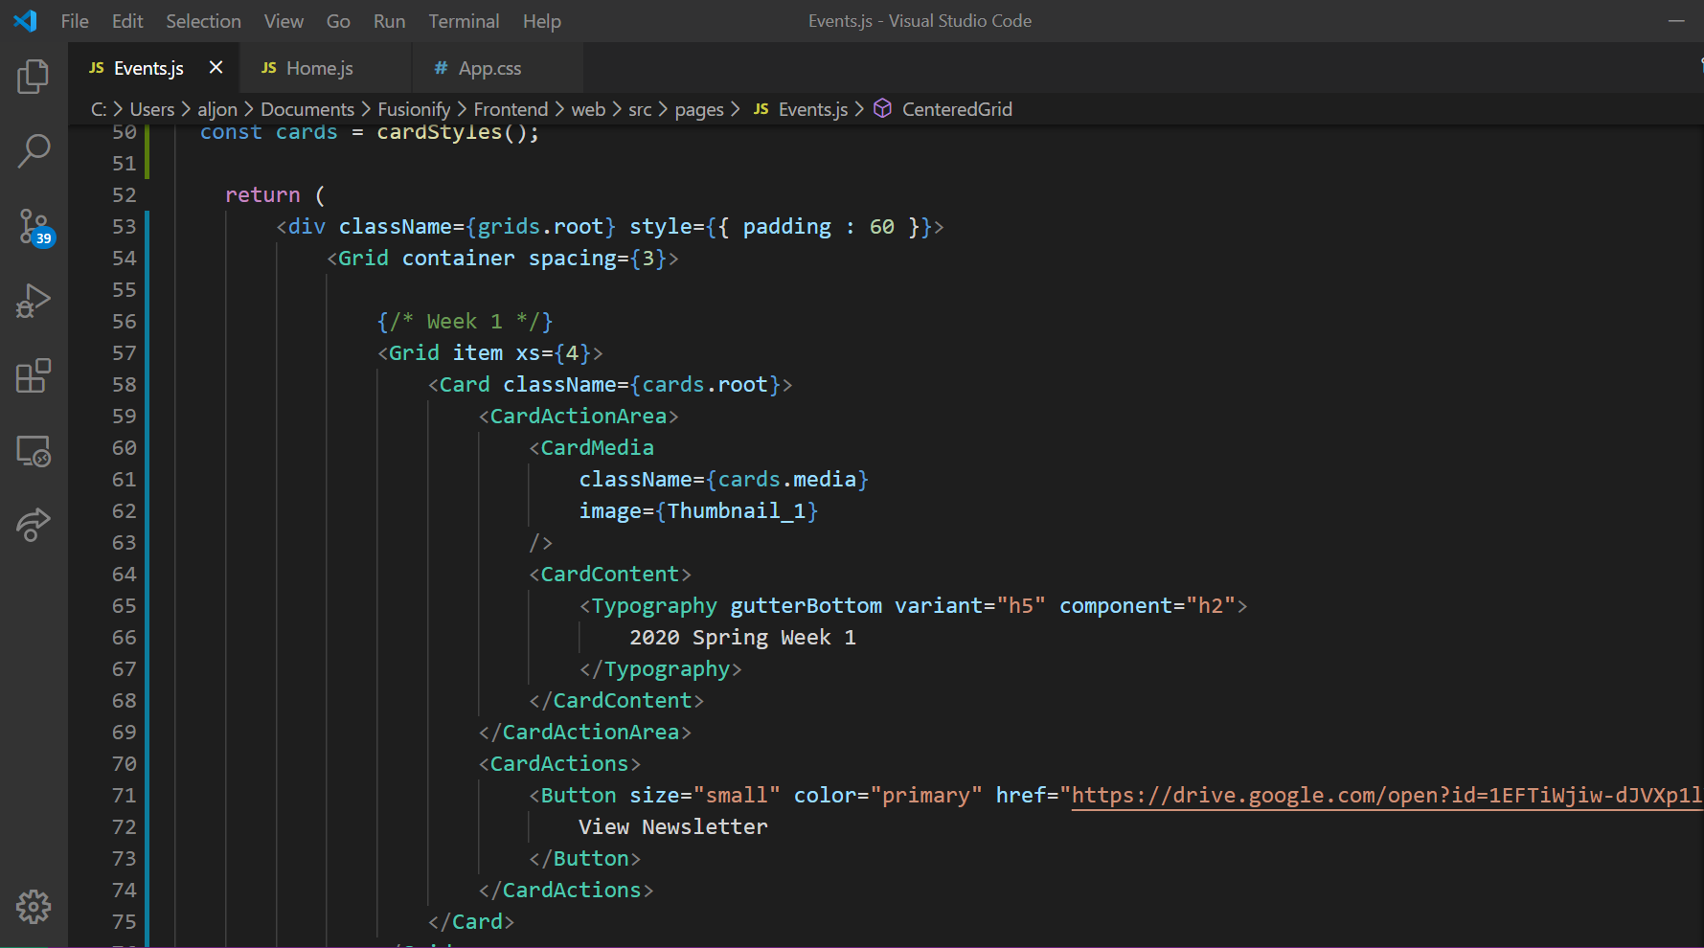
1337 Code

Slide 10
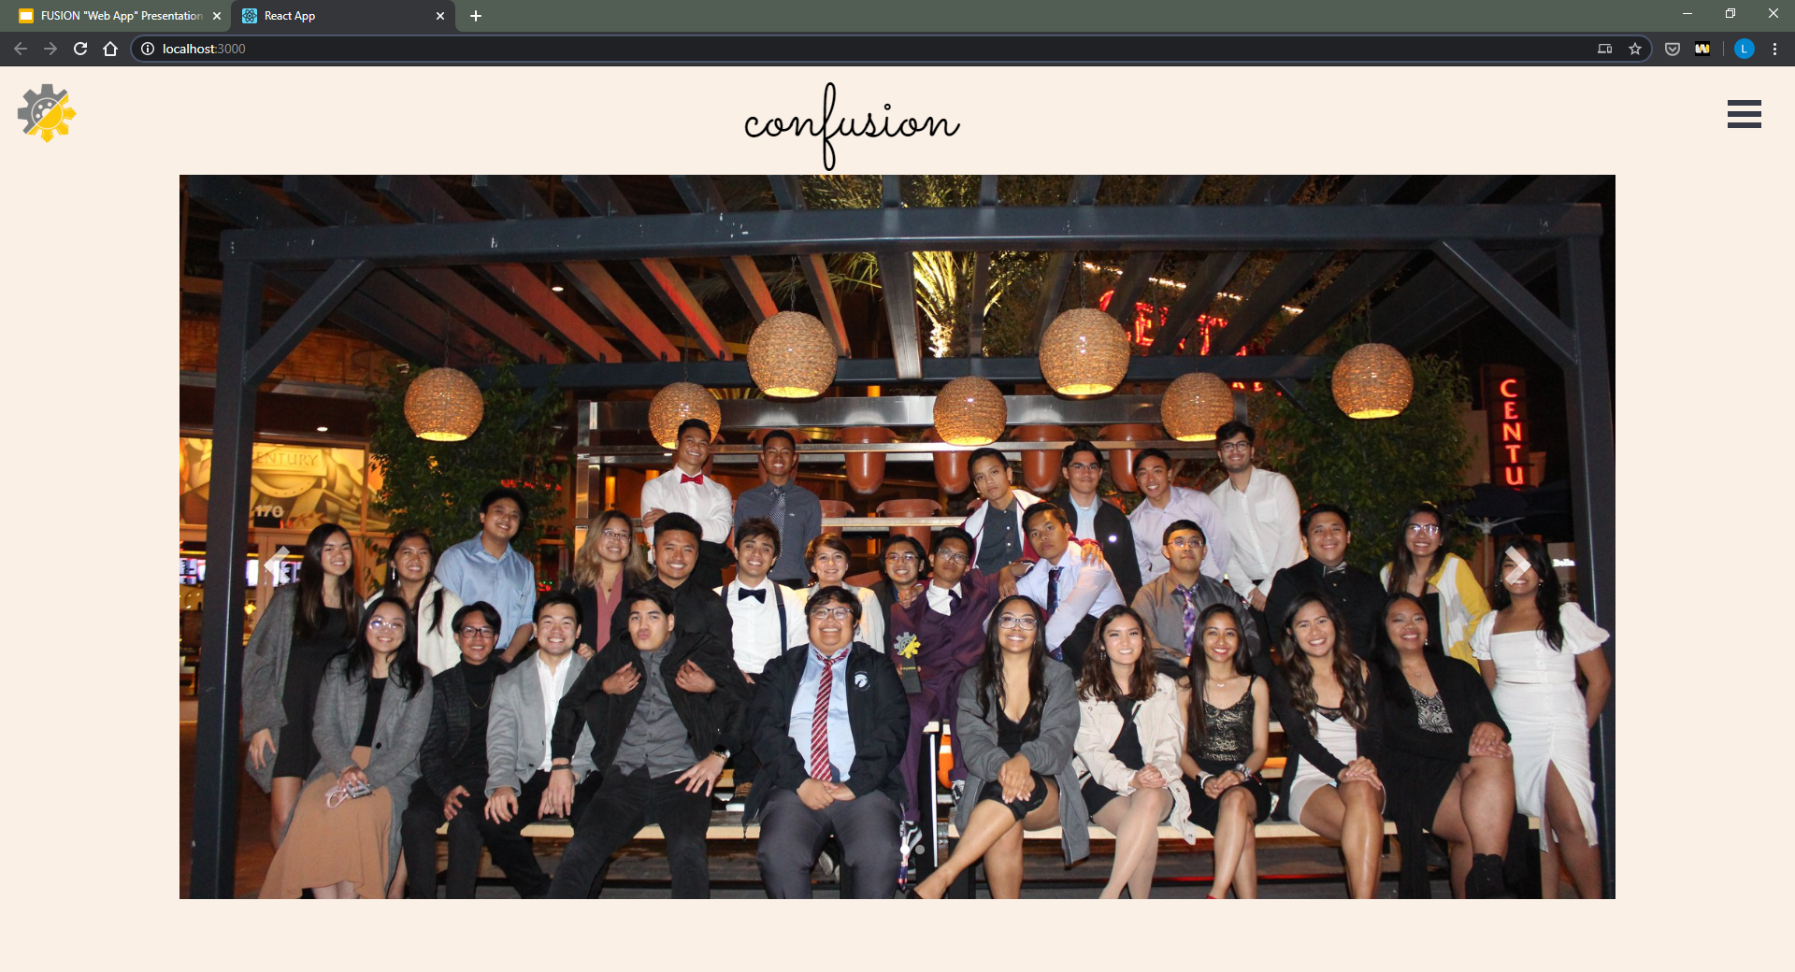

Slide 11
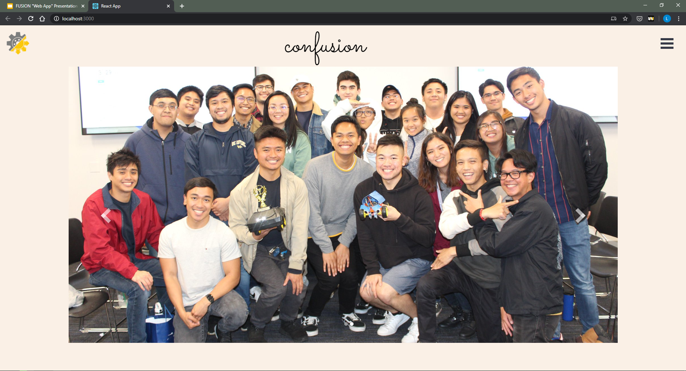

Slide 12
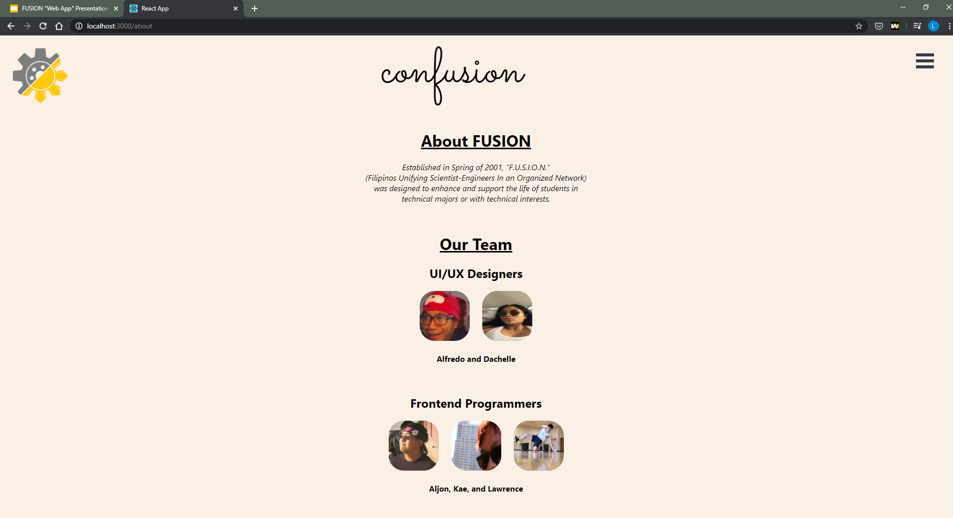

Slide 13
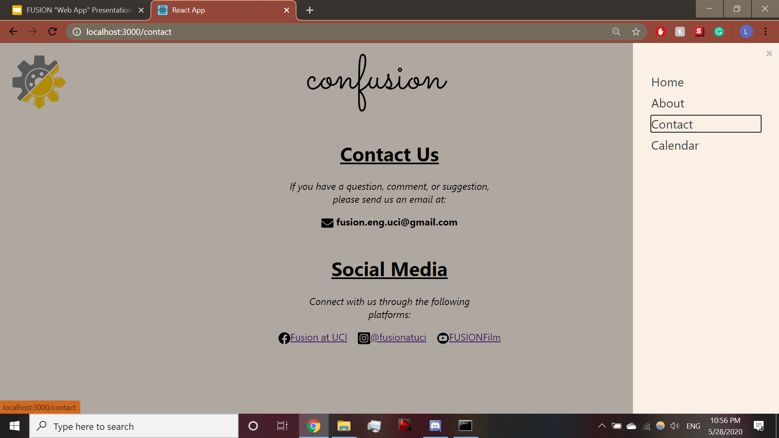

Slide 14
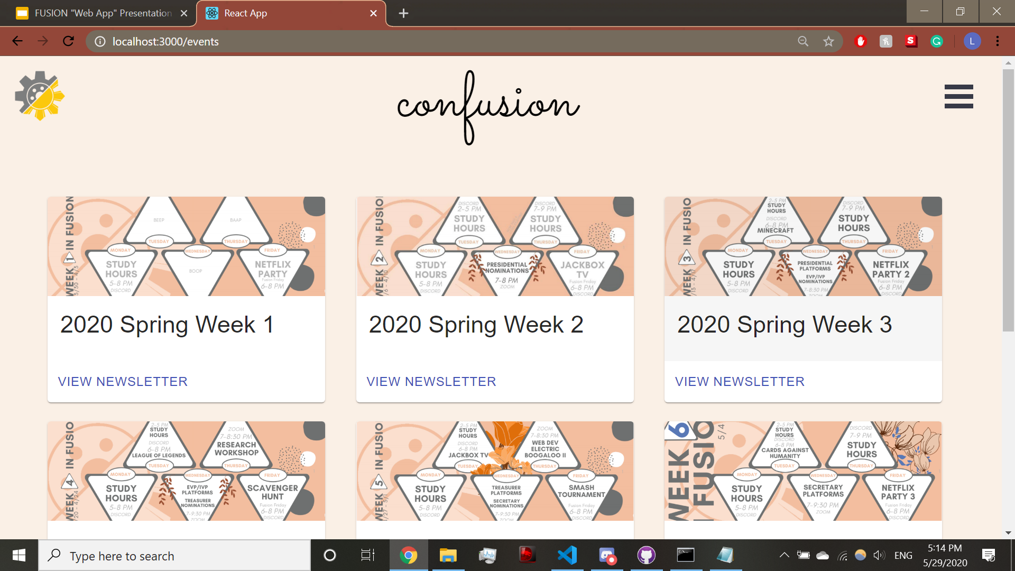

Slide 15
Future Plans
Goal Have the app in iOS and Android
Future Development
We plan to continue development and add new features to the project.
Convert the website into mobile app (React -> React Native)
Website Version
Archiving and showcasing FUSION stuff.
Import club photos and newsletter PDFs from Google Drive
(Board would just upload photos and the website automatically updates)

